Slide 1
Hybrid Adaptive Transformer
Differential Protection
An Intelligent DWT-LSTM Framework for 300 MVA Transmission Nodes
SYSTEM PARAMETERS
Target System: 300 MVA, 230kV/11kV Yd1 Wye-Delta
Core Methodology: Sim2Real / DWT Feature Extraction / Stateless ONNX LSTM

Slide 2
The Central Conflict: Security vs. Dependability in 87T Relays
The Safety Backbone (Dependability)
The Nonlinear Reality (Security)
Physics:
Physics:
Iron cores and current transformers possess inherent B-H non-linearities.
ANSI 87T relays supervise current balance (Idiff = |IHV - ILV|).
The Goal:
The Goal:
100% Precision. Avoid false blackouts during benign switching.
100% Recall for internal faults (e.g., inter-turn shorts).
The Threat (Synthetic Data Paradox):
The Threat:
Real-world stochastic transients—like magnetizing inrush and CT saturation—create severe spectral overlap with genuine faults, fooling traditional harmonic-restraint relays.
High-impedance faults often generate differential currents below standard 0.3 p.u. pickup thresholds, leading to missed trips.

Slide 3
Phenomenon Spectral Signature Matrix
Phenomenon | Amplitude | Harmonic Content | Symmetry | Time Behavior
Magnetizing Inrush | Large, decaying (2-10x rated) | High 2nd-harmonic (>15-20%) | Significant half-cycle asymmetry (unipolar spikes) | Temporal decay over cycles
Internal Fault | Large, sustained | Predominantly fundamental/odd | Generally symmetrical bipolar waveforms | Sustained until breaker clears
CT Saturation Artifacts | Clipped/abrupt truncation | Broadband high-frequency + distortion | May be one-sided/asymmetric | Can persist while CT remains saturated
THE AI IMPERATIVE: Faults are continuous sine waves. Inrush contains "dead intervals." CT saturation introduces high-frequency clipping. DWT is required to isolate these morphological differences in the time domain.

Slide 4
Proposed Architecture: The Hybrid Systems Framework
Pillar 1: The Nervous System (DWT)
Pillar 2: The Brain (LSTM)
Pillar 3: The Safety Backbone (Adaptive 87T)
Role:
Role:
"Spectral Lens" refinery process.
Temporal sequence pattern recognition.
Role:
Input:
Input:
Deterministic physics-based firewall.
16-sample sliding window (10ms / half-cycle at 1600 Hz).
32-step sliding window (20ms).
Input:
Output:
RMS current magnitudes (Idiff and Irest).
Output:
Floating-point confidence score (P_Internal) via Stateless ONNX.
Output:
6-dimensional energy feature vector (E_approx and E_detail via db4 wavelet).
Final tripping decision (incorporating the AI's supervisory veto).

Slide 5
The 'Two-Brain' Paradigm: Physics vs. Cognition
Classical Adaptive 87T Logic
WT-LSTM Supervisor
Foundation: First-principles physics (Kirchhoff's Current Law).
Foundation: Pattern recognition and waveform morphology.
Evaluation: Magnitude-based (RMS over a sliding window).
Evaluation: Time-domain transients (Wavelet energy spikes).
Strength: Deterministic, lightning-fast, highly dependable for major faults.
Strength: Cognitively aware of "out-of-distribution" distortions; ignores benign asymmetry.
Weakness: Easily fooled by the "funhouse mirror" of CT saturation; rigid thresholds limit high-impedance fault sensitivity.
Weakness: Stochastic nature inherently lacks physical fail-safes.
THE CONCLUSION: AI should not trip the breaker independently. It must act as a cognitive veto overlaying a deterministic physics baseline.

Slide 6
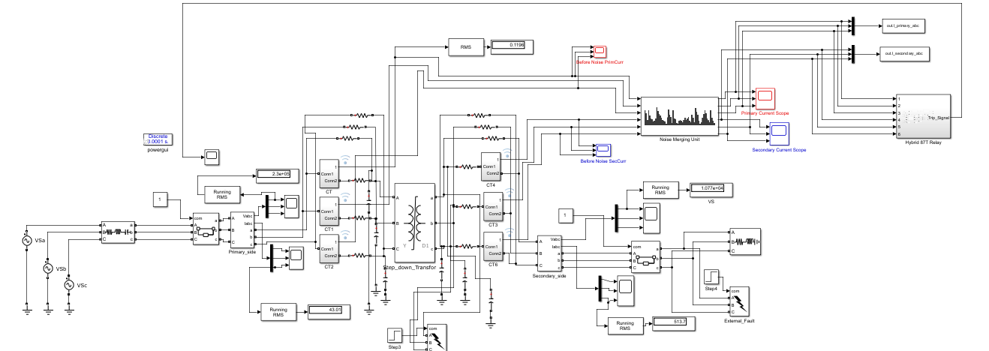
System Modeling: High-Fidelity Physical Plant
The Yd1 Transformer
Current Transformers (CTs)
300 MVA, 230kV/11kV. Modeled as three single-phase units to prevent artificial magnetic coupling between phases. Secondary voltage lags primary by 30 degrees.
20:1 ratio with defined burden and non-linear magnetization curves. Placed on both primary and secondary boundaries.
Vector Group Compensation
HV Wye currents are mathematically shifted -30 degrees to trap zero-sequence currents, fulfilling prerequisite 87T operational parameters.
Three-phase transformer model with CT saturation and vector compensation

Slide 7
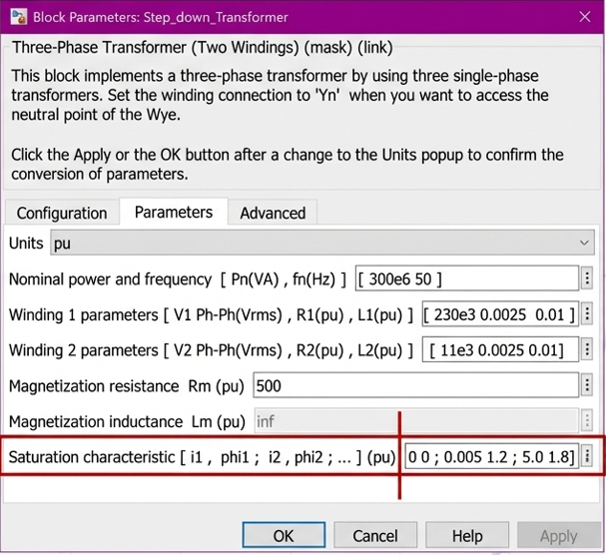
Generating 'Realistic' Transients: Magnetic Non-Linearity
The Saturation Characteristic Matrix
[0 0;
0.005 1.2;
5.0 1.8]
Physics (The Knee Point): Up to 1.2 p.u. flux, the core requires only 0.5% rated current.
Simulink Block Parameters
Physics (Deep Saturation): Pushing flux from 1.2 to 1.8 p.u. requires a 1000x increase in magnetizing current.
Step_down_Transformer configuration with saturation characteristics
AI Relevance: This non-linearity generates massive asymmetric harmonic-rich inrush spikes necessary for training.
Saturation: [0 0; 0.005 1.2; 5.0 1.8]

Slide 8
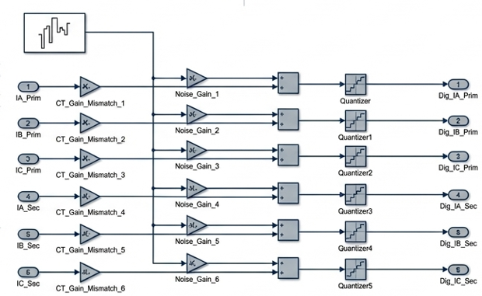
Crossing the Sim2Real Gap: Impairment Injection
Simulink Impairment Injection Model
Signal flow: IA_Prim → CT_Gain_Mismatch → Noise_Gain → Quantizer → Dig_IA_Prim
Hypothesis
Implementation
Implementation
Result
Training AI on "polite" simulation data creates models that fail against real-world sensor degradation.
Injected up to 2% independent gain error per phase. Band-limited White Gaussian Noise at 30dB to 15dB.
16-bit ADC block forces smooth sine waves into discrete staircase steps, mimicking digital relay hardware.
The LSTM is forced to learn true underlying fault morphology rather than memorizing perfect mathematical geometry.

Slide 9
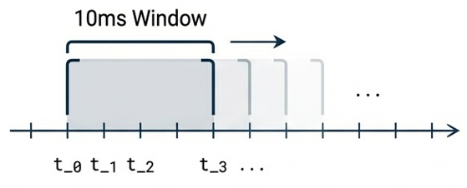
Feature Engineering: The DWT Refine
The Sliding Window Mechanics
Parseval's Theorem & db4 Extraction
Concept:
Method:
The relay cannot wait for a full offline dataset. It uses a "Time Machine" effect.
Daubechies-4 (db4) mother wavelet selected for its jagged, asymmetrical shape optimized for fault inception spikes.
Execution:
Dimensionality Reduction:
A 16-sample sliding window (10ms / half-cycle) shifts forward by 1 sample per discrete time step (t).
16 raw points convert into 2 energy features per phase.
Total 6-dimensional vector:
10ms Window
V_t = [E_approx_A, E_detail_A, ...]
AI Relevance:
E_approx isolates the smooth 50 Hz fundamental. E_detail acts as a "flare in a dark room," highlighting jagged fault transients.
tt_1 t_2 ... t_3 ...

Slide 10
The Supervisor: Attention-Enhanced LSTM Network
Global Temporal Attention
Recursive Hidden States & Weight Sharing
Stochastic Randomization (The Training Data)
Physics:
Training:
Batch script (ControlPanel.m) generates 1,000+ Monte Carlo scenarios varying critical physical parameters:
A fault inception may only last 2-5ms within a larger time window.
128 hidden units across 2 layers. Trained offline on 1601-step sequences (1.0 seconds).
Implementation:
Deployment:
Fault Resistance: 0.01 Ohms to 100 Ohms
Inception Angle: 0 degrees to 360 degrees
Remanent Flux: 0.3 p.u. to 0.9 p.u.
The Attention Mechanism forces the network to focus exclusively on high-energy transient milliseconds, ignoring pre-fault ambient spectral leakage.
Weight sharing allows the network to maintain temporal context when deployed on a 32-step (20ms) sliding window.

Slide 11
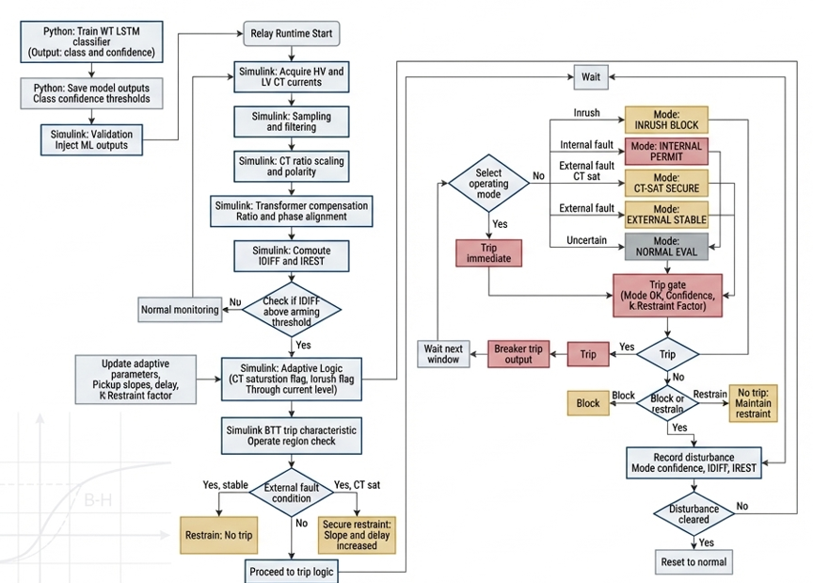
Real-Time Deployment: The ONNX Bridge
Mapping Python to Simulink
Exporting to ONNX: The PyTorch .pth checkpoint is compiled to a 'Stateless' Open Neural Network Exchange (ONNX) format using Opset 14 (optimized for RNNs).
Deployment Flowchart
Dynamic Axes
Python Training → Simulink Runtime → Decision Logic
Enables variable window sizes in Simulink, pruning the computational graph for speed.
Python: Train WT LSTM, Save thresholds
Simulink: Acquire CT currents, Filtering, Scaling
Logic: Check IDIFF, Adaptive parameters, Trip decision
Inference Speed
Simulink's 'Predict' block utilizes C++ execution to run the LSTM matrix multiplications in ~2ms—negligible compared to the 40-60ms mechanical delay of an SF6 breaker.

Slide 12
SYNTHESIS: The Hybrid Decision Handshake
Physical Phenomenon | 87T Relay Math | ML Confidence Score | Decision Handshake
Internal Fault | Operates | High (>= 0.85) | TRIP
High-Res Fault | Restrains (Miss) | High (>= 0.85) | TRIP (Sensitivity Gain)
Magnetizing Inrush | Operates (False) | Low Confidence | BLOCK (Veto applied)
Ext. Fault (CT Sat) | Operates (False) | Low Confidence | BLOCK (Veto applied)
THE FAIL-SAFE (Two-Key Protocol Override)
Instantaneous Overcurrent Override: If Idiff > 10.0 p.u., the system bypasses the AI completely to clear catastrophic faults instantly, prioritizing absolute grid survivability over classification depth.

Slide 13
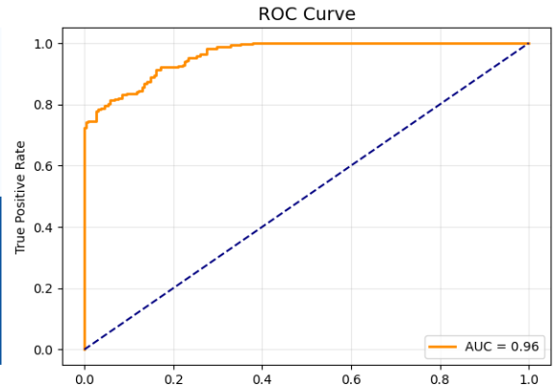
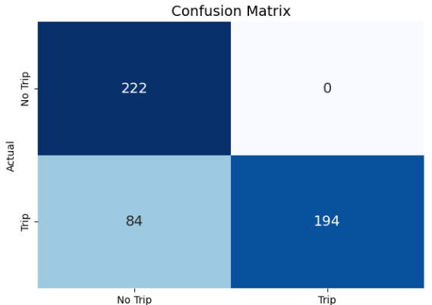
Offline Validation: Establishing Baseline Efficacy
Statistical Performance
Confusion Matrix Analysis
K-Fold Validation:
194
True Positives:
5-Fold Cross-Validation utilized to ensure robustness against varying fault resistances and inception angles.
Correctly identified internal faults.
222
True Negatives:
Metric Highlights:
Successfully restrained during normal load, inrush, and external faults.
The ROC curve demonstrates an AUC of 0.96, proving the db4 wavelet successfully decoupled raw transients into a linearly separable feature space for the LSTM.
84
False Negatives:
Indicates the boundary limits of the AI during extremely low-energy fault conditions (explored in Stress Testing).
0.96
AUC Score
Confusion Matrix: [222, 0; 84, 194]

Slide 14
System Limitations & Stress Test Outcomes
The 45 Ohm Breaking Point (Dependability)
Extreme Noise Immunity (Security)
Deep CT Saturation (Security)
Condition:
Condition:
Condition:
15 dB AWGN injection (simulating severe substation EMI).
80% Remanent Flux (0.8 p.u.) during external through-faults.
High Impedance Faults (HIF) ranging from 50 to 100 Ohms.
Result:
Result:
Result:
Precision remains 100% . The AI correctly ignores high-frequency jitter.
Precision remains 100% . The AI identifies morphological "flat spots."
Recall drops to 69.8% . The E_detail wavelet energy signature becomes too small.
Proof:
Action:
Action:
Proves the robustness of the DWT refinery against false trips.
Successfully issuing the BLOCK veto.
Relay defaults conservatively to adaptive Springer logic.

Slide 15
Conclusion
Mathematical Rigor Meets Cognitive Awareness
Transitions transformer protection from fixed-threshold harmonic math to adaptive, time-domain morphological analysis.
The 'AND-Gate' Paradigm
Proves that AI does not need to replace deterministic physics. As a supervisory veto, it achieves 100% precision without sacrificing the safety of Kirchhoff's laws.
Real-Time Viability
The 2ms stateless ONNX inference speed confirms that deep learning can operate well within the 40-60ms mechanical limits of modern SF6 circuit breakers.
The integration of Hybrid AI into the relay chassis marks a definitive step toward a resilient, self-aware, and autonomous Smart Grid.

